Slide 1

RendezViewz
Hi-fi Prototype Checkpoint
~Life of the watch party~

Slide 2
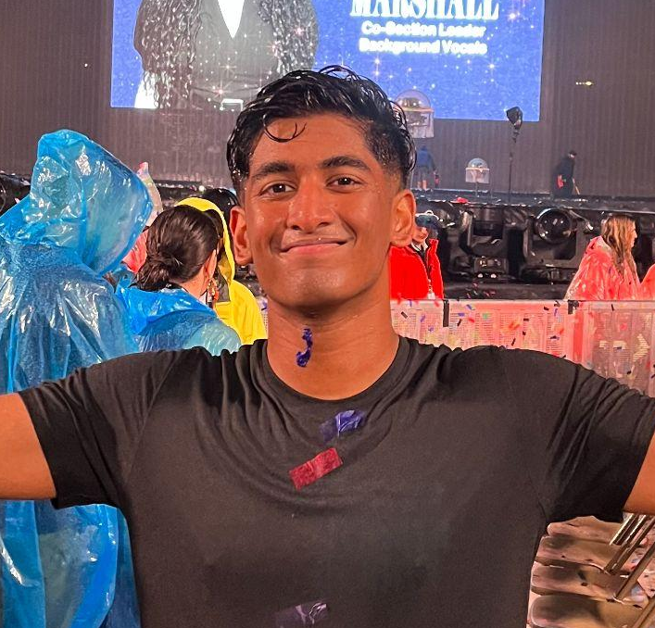
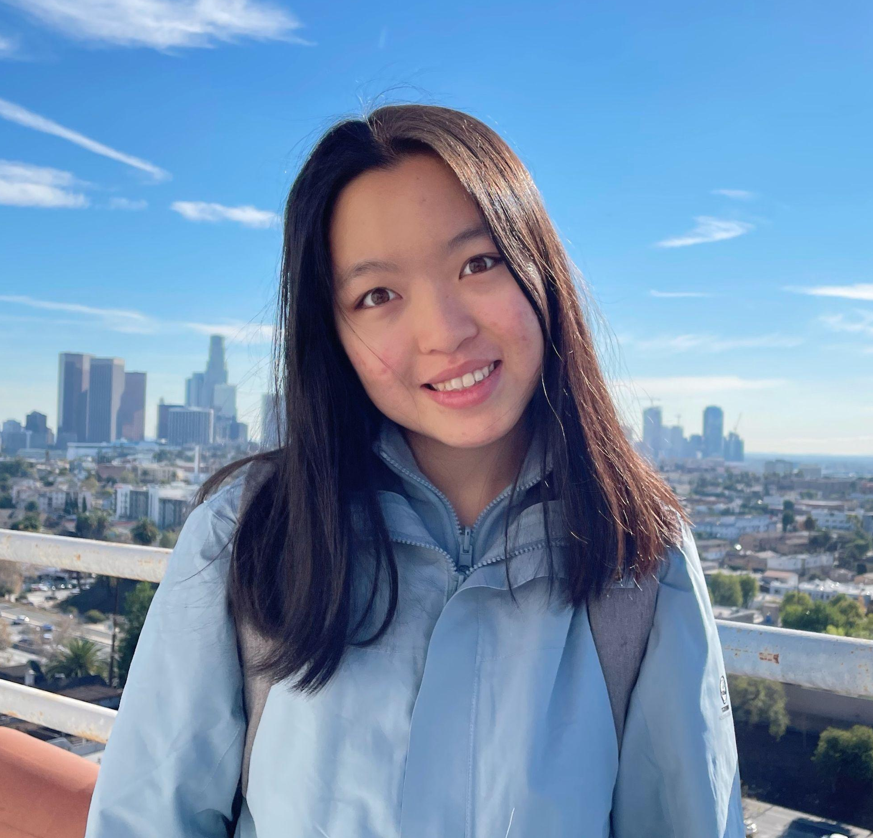
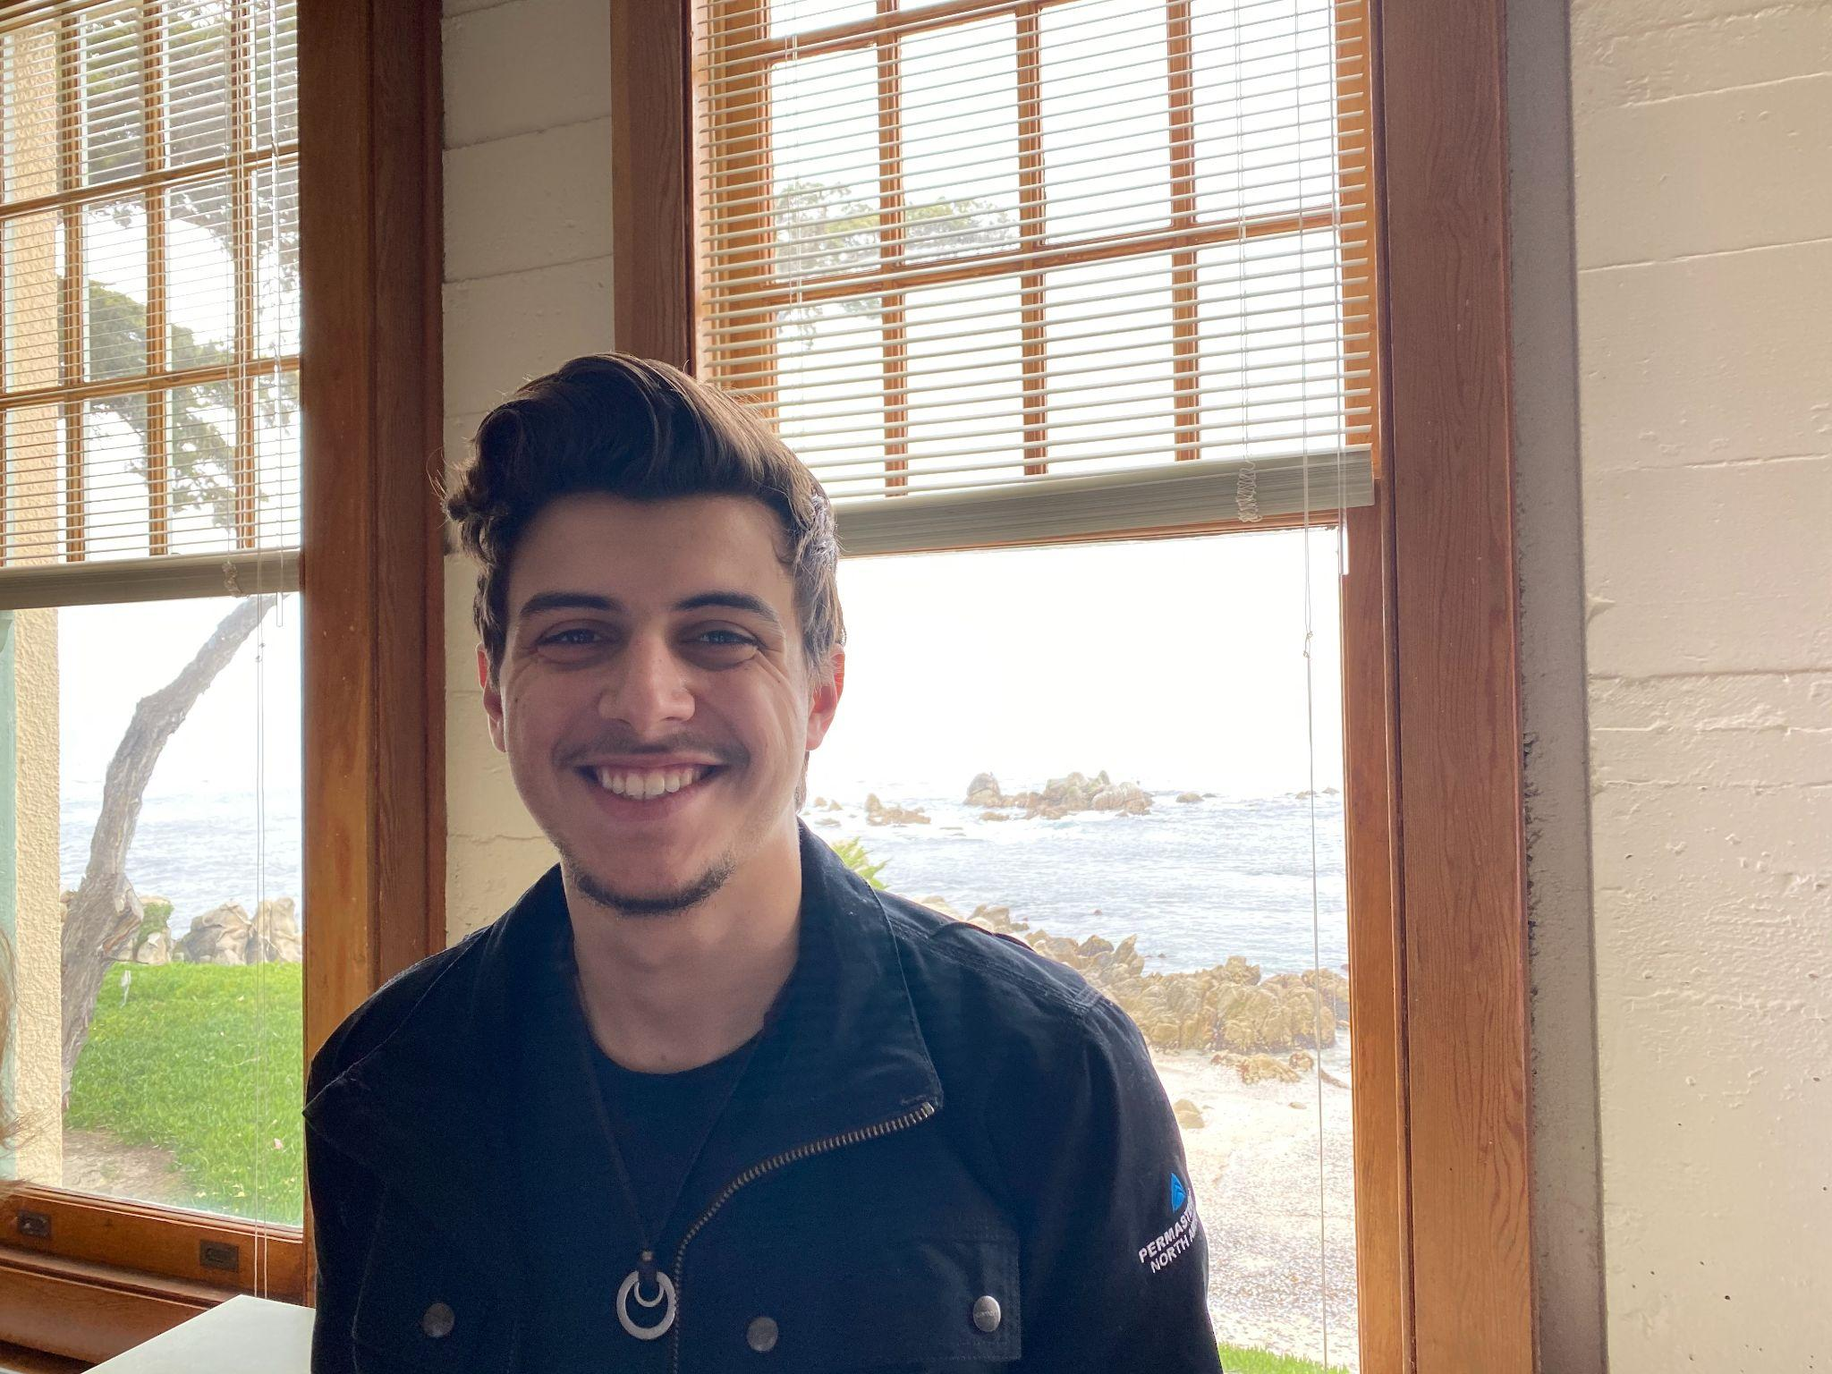
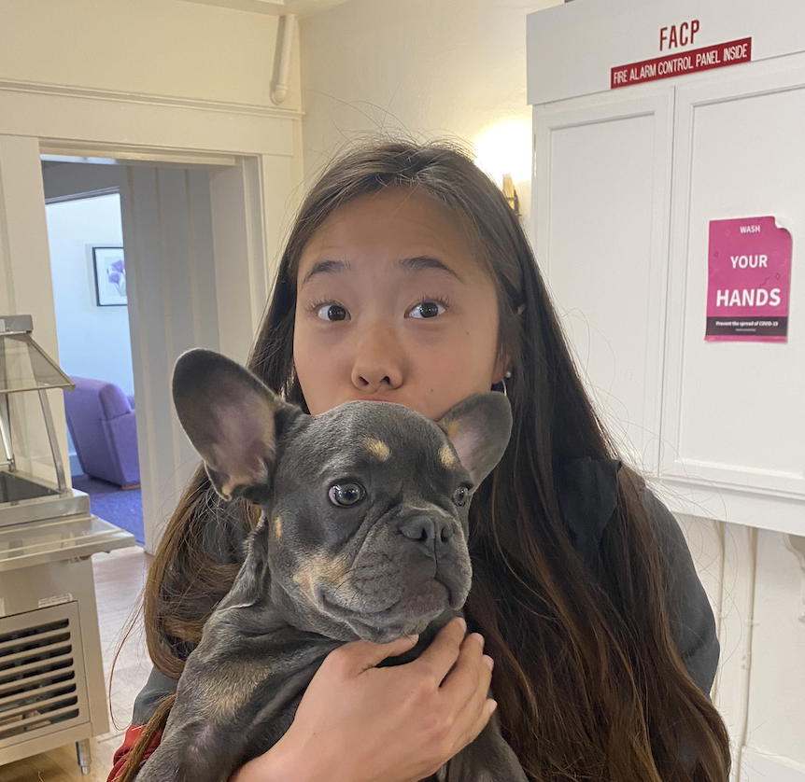
Meet Our Team
Allen Naliath
Charlotte Zhu
Francis Santiago
Yishu Chen
‘25
Boston, MA
‘25
Suzhou, China
‘23/’24
Miami, FL
‘23/’24
Hong Kong

Slide 3
The Problem

Slide 4
The Problem
We realized that people often associate sports with a social watching experience, but not other types of video content.

Slide 5
The Problem
We realized that people often associate sports with a social watching experience, but not other types of video content.
The current solutions in our problem space often involve no space for small, tight-knit social interactions.

Slide 6
The Problem
We realized that people often associate sports with a social watching experience, but not other types of video content.
The current solutions in our problem space often involve no space for small, tight-knit social interactions.
We wanted to help encourage and facilitate meaningful, small-scale social experiences surrounding all types of video content.

Slide 7
The Solution
A media sharing app that leverages the ease and social aspects of listing and ranking shows to engage users and spark interactions surrounding TV/movies . Inspired by friends’ sharings, one can then easily arrange virtual or in-person watch sessions.

Slide 8
Value Proposition
Connect over cinema: Discover, rank, and watch movies and shows seamlessly with friends. Know what they're watching, easily share your favorites, reach out without fear and enjoy together.

Slide 9
Roadmap
01
02
03
Heuristic Evaluation Results
UI & Product Revisions
High-fi Prototype
04
Demo!

Slide 10
Roadmap
01
Heuristic Evaluation Results

Slide 11
Summary

Slide 12
49 total violations
1 severity 0
14 severity 1
20 severity 2
13 severity 3
2 severity 4
H3: User Control (9/49)
H4: Consistency & Standards (6/49)
H11: Accessible (6/49)

Slide 13
Sev. 3 & 4

Slide 14
Most severe violations summary
Red/green color on map confusing
Share location permission missing
Allow like and unlike
Distinguish between ranking vs adding
Home icon not visible everywhere
Ability to unselect friend from invite missing
Easier way to select time for invites
Getting to chat without going through invites

Slide 15
Roadmap
01
02
Values in Design
UI & Product Revisions

Slide 16
Overviews of Changes
Home Page / Feed
renovating the menu bar
allow like and unlike, distinct colors for the icon
ability to comment
Calendar
Easier way to select time for invites
Friends Page
Getting to chat without going through invites

Slide 17
1: Home Page

Slide 18
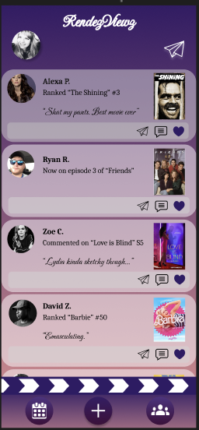
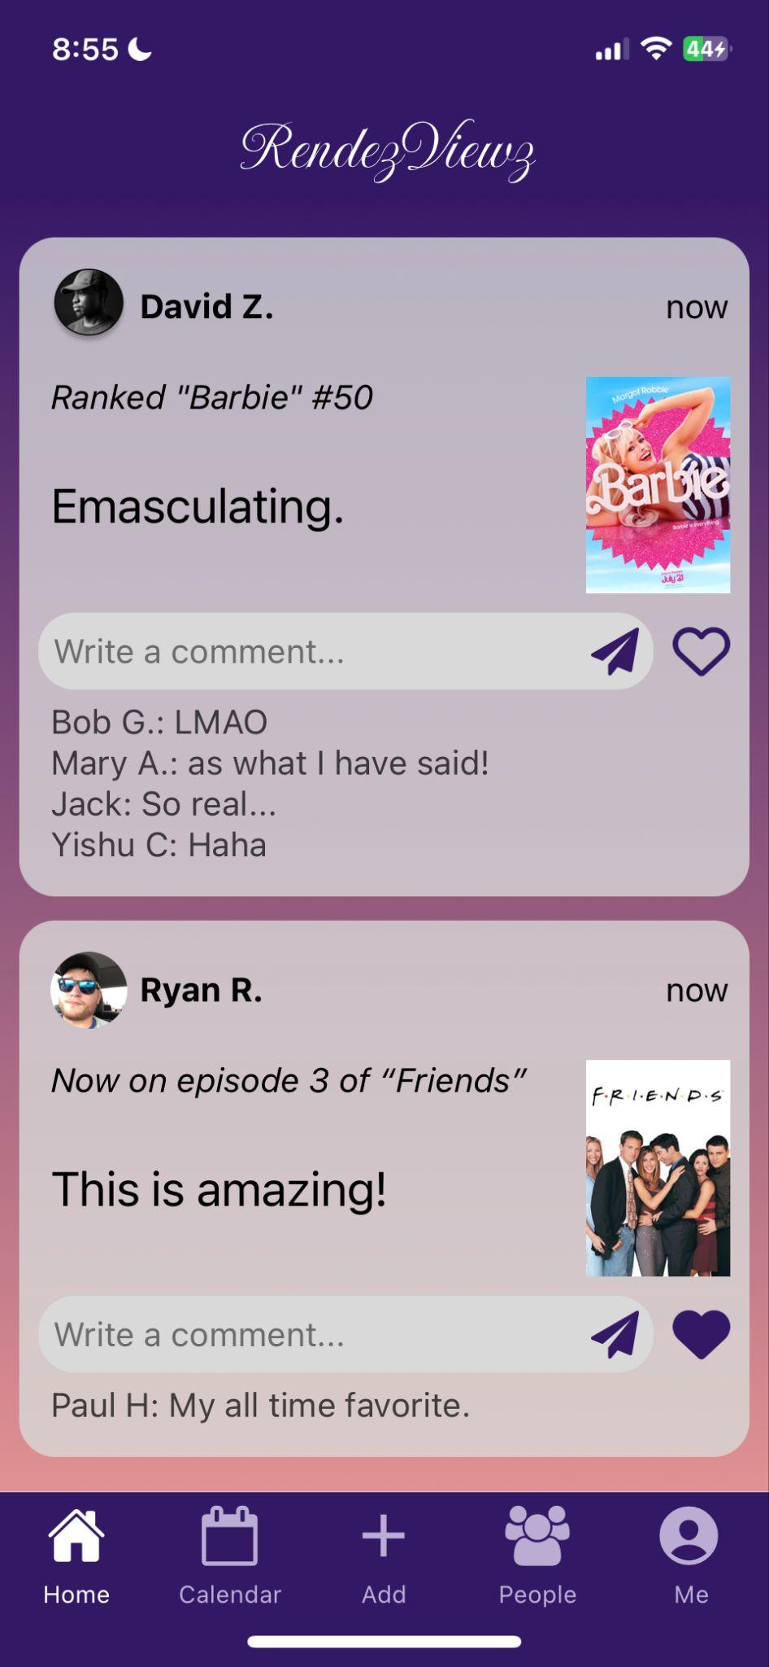
Change #1: Home Page
Violations: Confusing menu bar, cannot unlike (H3), Text font hard to see (H8/11)
Fix: Clear labels, ability to unlike, Consistent font
Notes:
We’ve had many different iterations of the menu bar. The first resembles our low-fi prototype with the pop-up movie thing. We received a couple of feedbacks: 1) make it fit in more with the style of the rest of the app, 2) It’s a little odd to have content passing behind 3) It’s taking up too much real estate on the page. We first took care of the style aspect and made it fit in more stylistically. However, we also wanted to incorporate feedback that it didn’t look very clean with feed content still passing in the background, so we eventually landed on the third design, a simple footer menu bar that had the original buttons, but spans across the whole page and still keeps the fun movie bar element. We also made it minimized when not in use to save real estate. Whenever one needs the menu bar, we can just click to make it pop up.

Slide 19
Feedback & Implementation
1
Home icon inconsistent and hard to find (H3)
-> home icon in footer for easy and consistent access
-> Labels for clear understanding
2
Confusing like icon and inability to unlike (H3)
-> Empty heart vs Solid heart; one tap to unlike
3
Text font & display of post might be hard to see (H8 / H11)
-> Consistent font; larger size of each post and post content
Notes:
H3: User Control
H8: Minimalist Design
H11: Accessibility

Slide 20
Rationale
1
Easier access to all functionalities
2
Consistency in terms of where to find pages
3
More clarity on the page that icons lead to

Slide 21
Usability Goal/Measurement Relevance
02
Flexibility
01
Ability to maneuver between different pages and unlike a post with one click
Efficiency
One click to any page, improved efficiency
03
Learnability
04
Enjoyment
Highly consistent layout, very learnable
More fun to see all the possibilities/ options!

Slide 22
2: Calendar

Slide 23
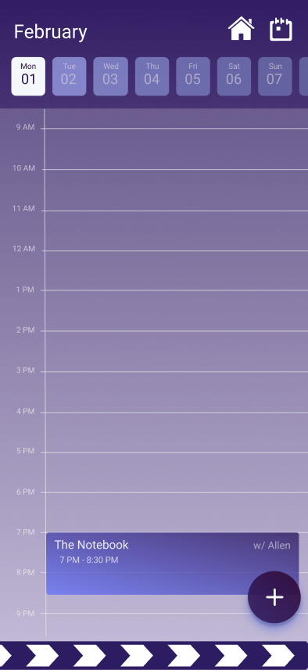
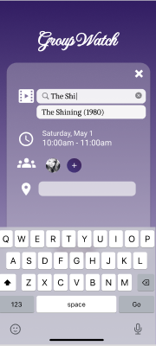
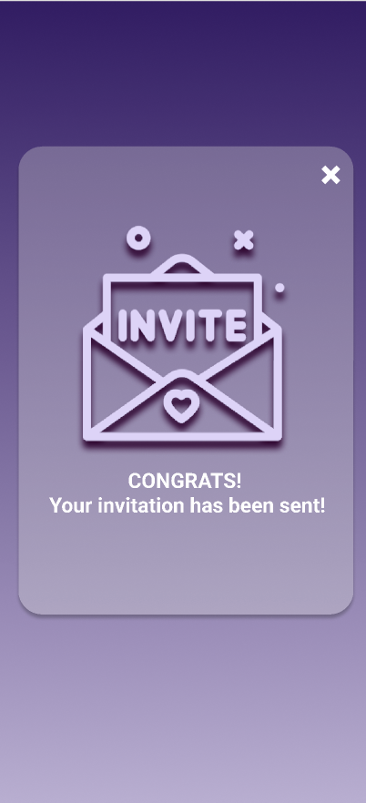
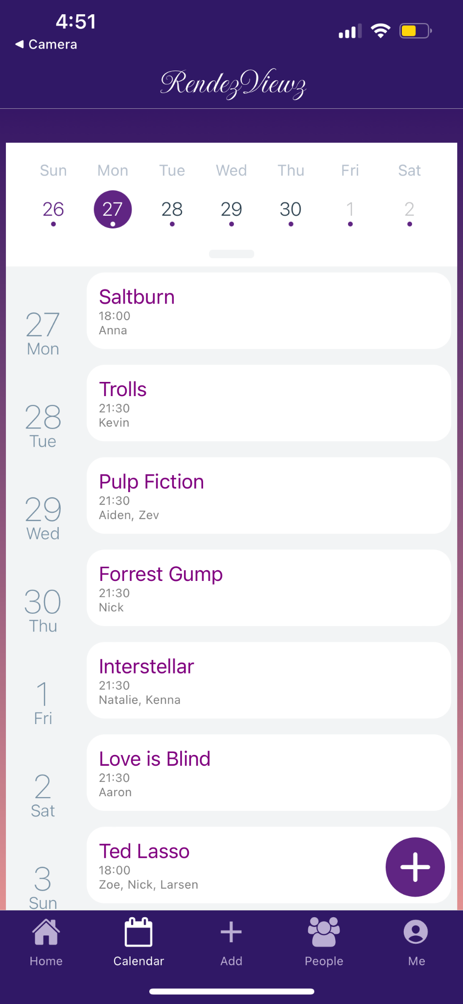
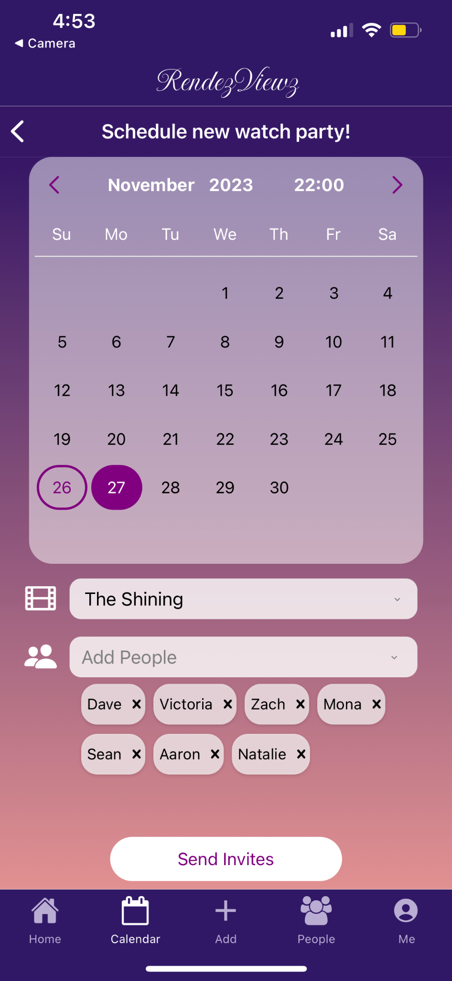
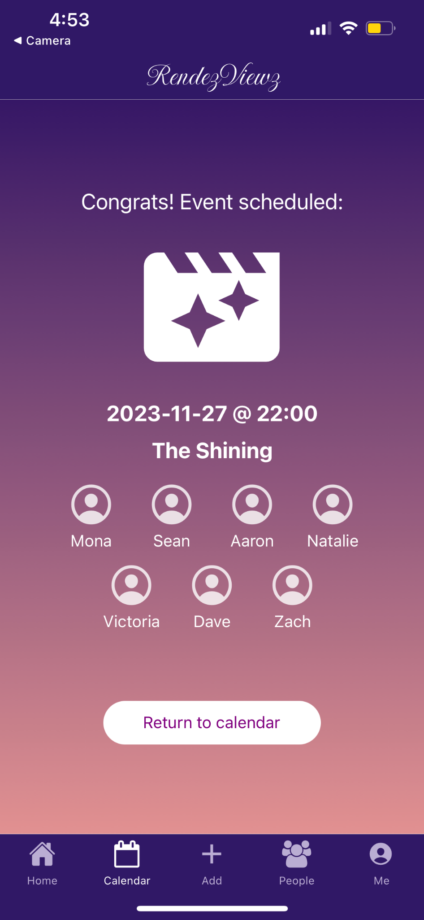
Change #2: Calendar
Before: Top right button to expand calendar, pop up add window, cute invite screen
After: Swipe down view for calendar and full screen add, more modern invite sent screen
Notes:
We’ve had many different iterations of the menu bar. The first resembles our low-fi prototype with the pop-up movie thing. We received a couple of feedbacks: 1) make it fit in more with the style of the rest of the app, 2) It’s a little odd to have content passing behind 3) It’s taking up too much real estate on the page. We first took care of the style aspect and made it fit in more stylistically. However, we also wanted to incorporate feedback that it didn’t look very clean with feed content still passing in the background, so we eventually landed on the third design, a simple footer menu bar that had the original buttons, but spans across the whole page and still keeps the fun movie bar element. We also made it minimized when not in use to save real estate. Whenever one needs the menu bar, we can just click to make it pop up.

Slide 24
Feedback & Implementation
1
Expand calendar icon unintuitive (H7)
-> We now have a more intuitive swipe down calendar expansion
2
No options/edits for input fields (H3)
-> All input fields accept changes and have multiple options
3
Invite page childish, odd style (H8)
-> We modified it to be more modern and fit in better with the style of the app
Notes:
H3: User Control
H7: Efficiency of Use
H8: Minimalist Design

Slide 25
Rationale
1
More style consistency
2
More input flexibility
3
Larger view, more accessible
4
More intuitive operations

Slide 26
Usability Goal/Measurement Relevance
01
02
Flexibility
Efficiency
More intuitive design, higher speed & efficiency
Ability to modify input, higher flexibility
03
Learnability
04
Enjoyment
Consistent layout, same setup for each request, very learnable
Smoother operation, easier to enjoy the actual function

Slide 27
3: Friends

Slide 28
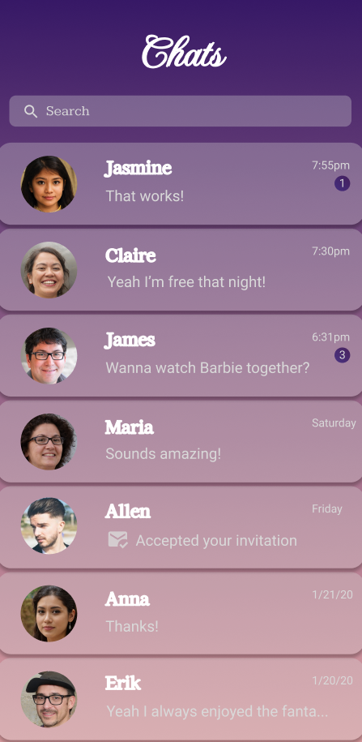
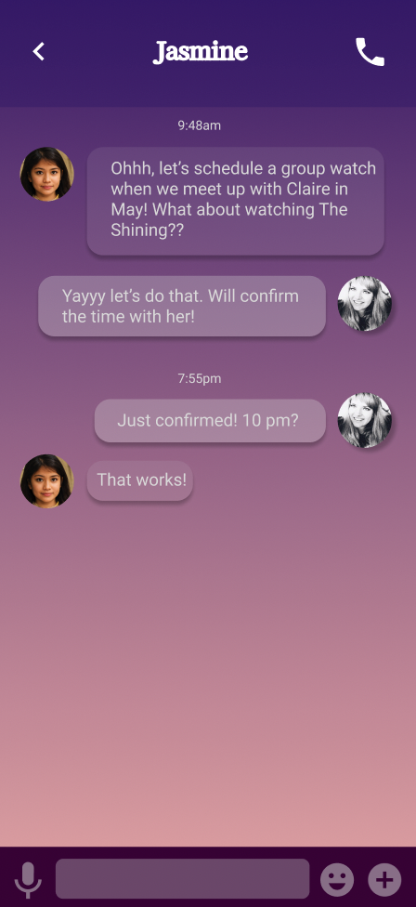
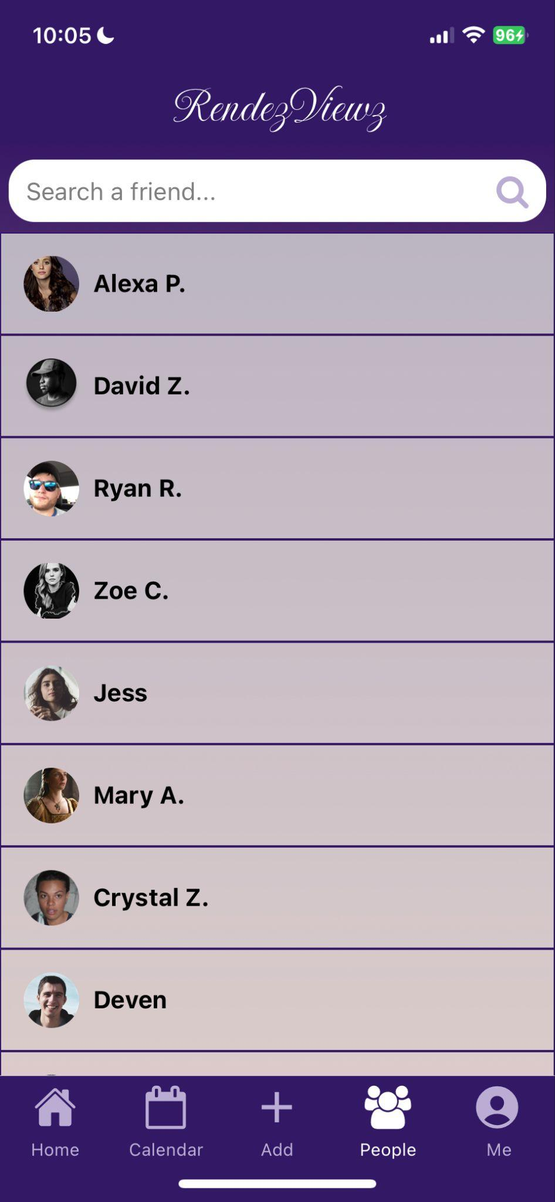
Change #3: Friends
Before:
Could not navigate to friends in task flows
Figma
Implementation
After: Access friends and chat / schedule directly
Notes:
We’ve had many different iterations of the menu bar. The first resembles our low-fi prototype with the pop-up movie thing. We received a couple of feedbacks: 1) make it fit in more with the style of the rest of the app, 2) It’s a little odd to have content passing behind 3) It’s taking up too much real estate on the page. We first took care of the style aspect and made it fit in more stylistically. However, we also wanted to incorporate feedback that it didn’t look very clean with feed content still passing in the background, so we eventually landed on the third design, a simple footer menu bar that had the original buttons, but spans across the whole page and still keeps the fun movie bar element. We also made it minimized when not in use to save real estate. Whenever one needs the menu bar, we can just click to make it pop up.

Slide 29
Feedback & Implementation
1
Difficult to Navigate to Friends Directly (H7)
-> Added People Tab in the navigation bar to access conversations/plans directly
2
Text was hard to read, poor contrast (H8, H11)
-> Consistent card style and background to increase contrast; more readable font size and style
Notes:
H7: Efficiency of Use
H8: Minimalist Design
H11: Accessibility

Slide 30
Rationale
1
Easier access to main functionalities
2
Better readability and accessibility
3
More intuitive navigation

Slide 31
Usability Goal/Measurement Relevance
01
02
Flexibility
Efficiency
One click to chat, improved efficiency
Can choose when in the flow to interact with friends
03
Learnability
04
Enjoyment
More consistent layout, more simple
Message friends at your own pleasure, less structured

Slide 32
Roadmap
01
02
03
Heuristic Evaluation Results
UI & Product Revisions
High-fi Prototype

Slide 33
Implementation

Slide 34
Framework/tool

Slide 35



We used…
Feed / Friends:
React native linear gradient for background
Flatlist for displaying posts / friends
Supabase for storing posts, comments, like condition, images
Figma
design revisions
Expo Router
Calendar:
React native calendar agenda for basic calendar w/ event view
Stack for adding event
Dropdown bar packages for selection options
backend: store data

Slide 36
Implemented Features

Slide 37
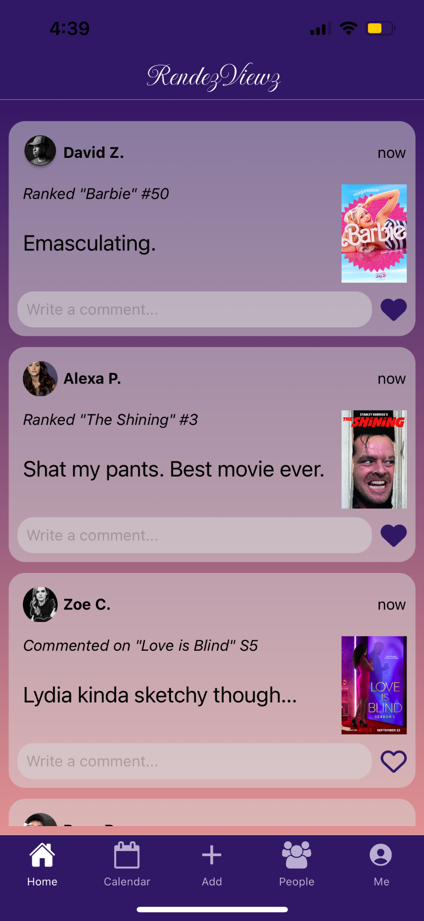
Feed
Developing Version
Current Version

Slide 38
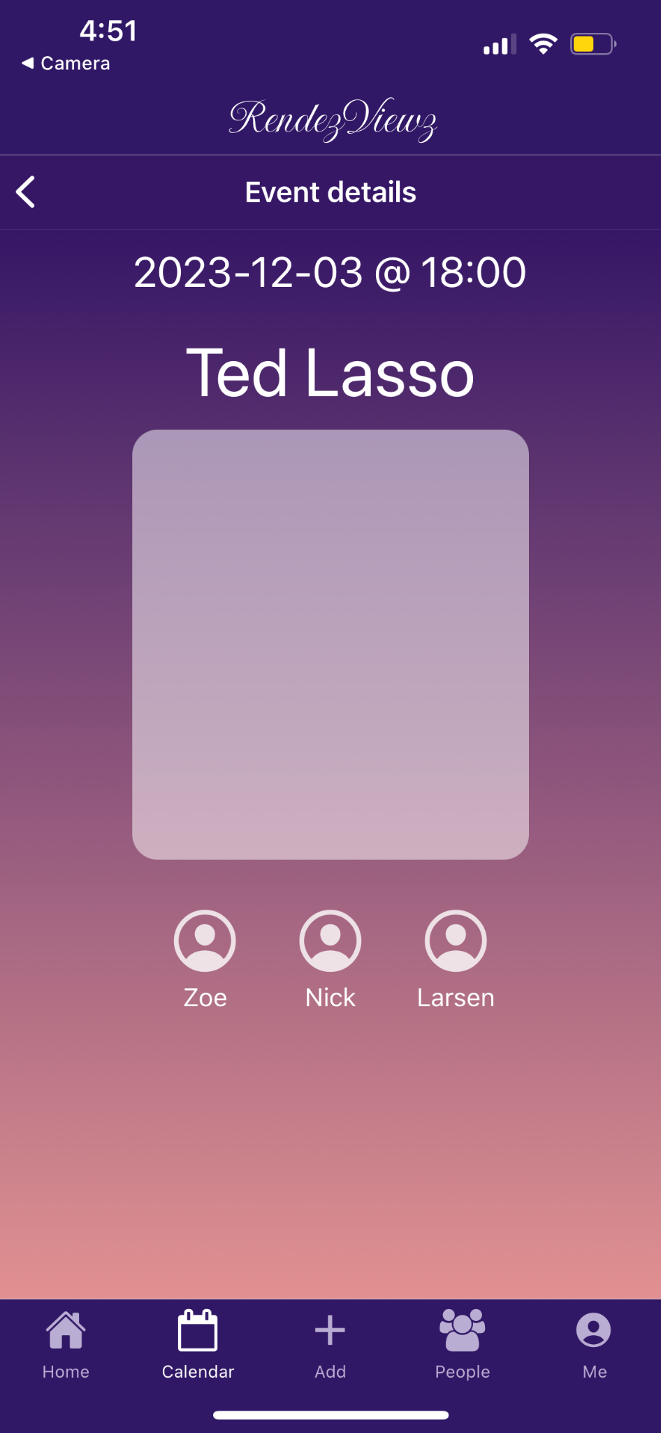
Calendar Scheduling

Slide 39
Friends
Drop down and Search function still under implementation

Slide 40
Unimplemented Features + Plan

Slide 41
We have yet to implement…
Profile page
Movie page
Add function
Map (Allen)
Friends (Charlotte)
  Drop-down bar / Search a friend
  Message Page
Feed: (Charlotte)
  Ability to post
  Connecting add/rank activity to posting
Calendar: (Yishu)
  Error handling messages and mechanism

Slide 42
Hard Coded

Slide 43
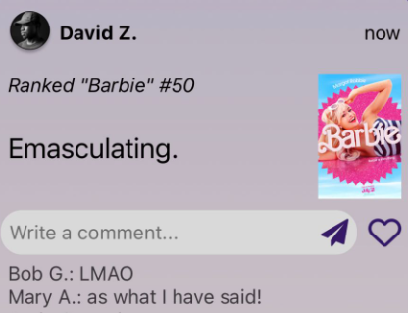
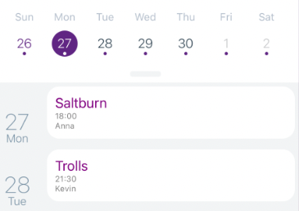
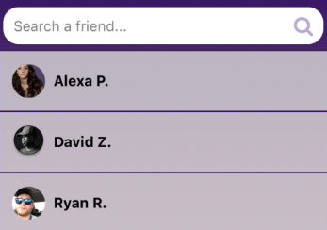
Hard-coded features
Feed Post
Calendar Layout
Friend List

Slide 44
Wizard of Oz features
database/dataset used to populate the feed posts and calendar events are artificially created but it seems to be created by multiple users
“send” schedule the event for users but only appear in the current user’s calendar
“Preference Match” return friends that are more likely to watch the film with you in scheduling

Slide 45
Challenges
Supabase: navigating tables and efficient ways to store data
Link: functions between different parts of the app, for example, add a film should result in a post on feed
Interactions between users: how to add a friend? chat function & schedule a group watch within chat

Slide 46
Questions?

Slide 47
Thank you!

